Slide 1
PostgreSQL MongoDB
w/ Gil B.
Notes:
Make w/ Meroxa in Minutes, not Months

Slide 2

The Problem
Notes:
You ever been stuck at your desk dreading the thought of another month long data-sync project that didn’t have to be that long?
Have you ever wondered if you or a loved one was seeking copensation due to back to back situations of this nature?
“ Are you tired of living in a world, where syncing databases to each other or warehouses takes a month and makes good people cry at their desk?”
I’m gonna let you in on a little secret, those days are coming to a close, and if you keep your hands and feet inside the vehicle you wont end up like these women. . .
*Boom, sadness*
The problem is syncing data and how long it usually takes to run or automate this task.

Slide 3
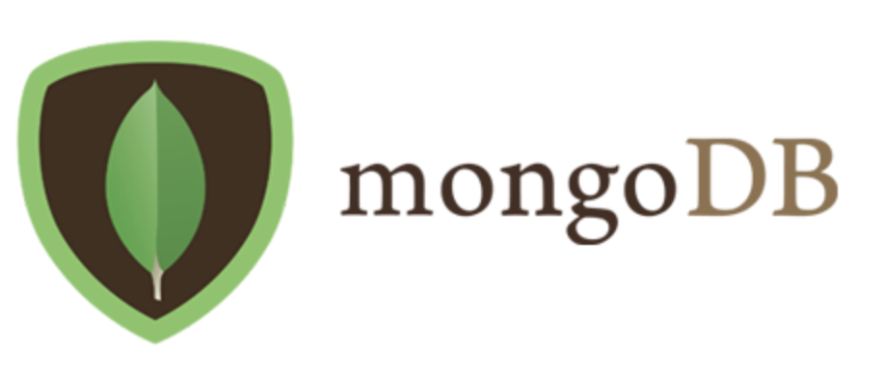
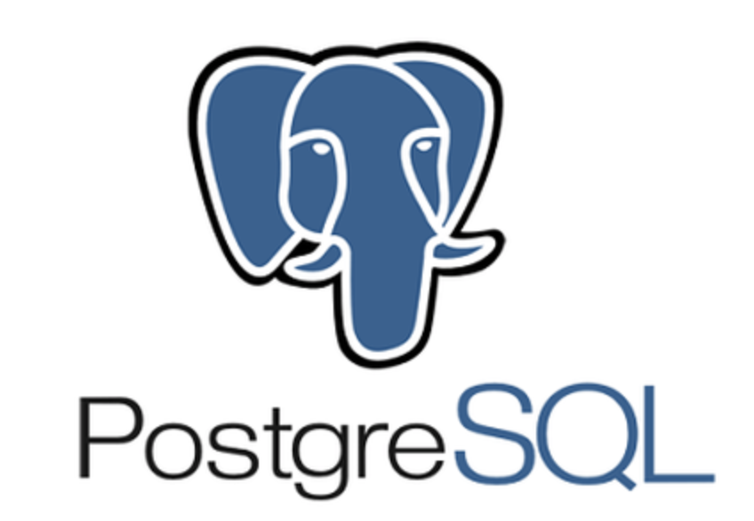
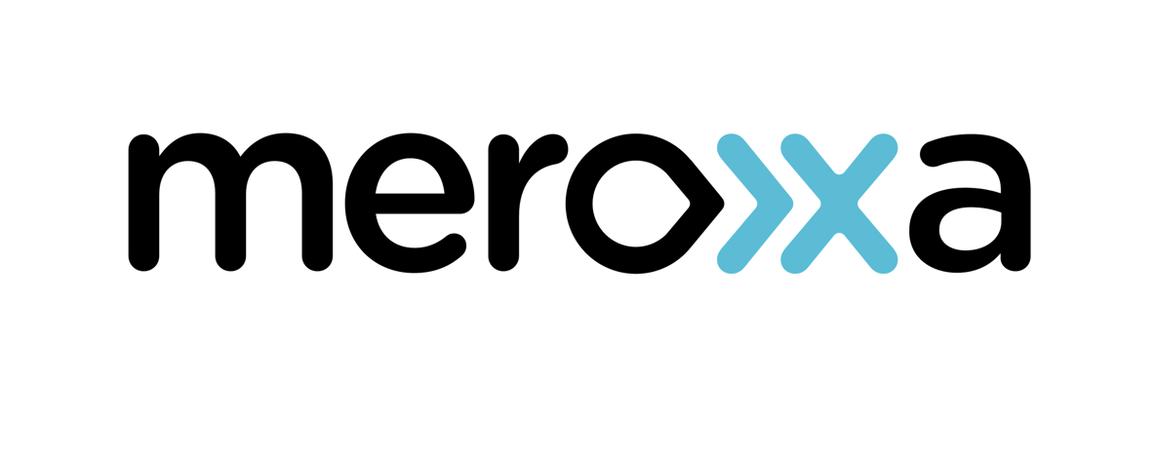
Prerequisites
Notes:
Before you start, you need these:
PostgreSQL here
MongoDB Atlas here
Create an account, log in and configure according to HERE. Make sure both of your databases are running and are able to receive connections. Test them using these commands (telnet, netcat) or your preferred tools.
Once the databases are connected, up and running - you can head to the meroxa site to download the CLI. Make sure to create an account and log in!

Slide 4
StoryTime
Notes:
Tell a story about that time when you had to sync information out of postgres into mongodb

Slide 5

Like this

Slide 6

Demo
Notes:
Navigate to the CLI to demonstrate and or create a new situation.
Name orgn tom , name dst jerry
Create connectors named chase
Then head to table postgres device and add data
Head to mongodb atlas and view collections
Loved the ease of use, loved the documentation - I got turned around

Slide 7

This guy, am I right?
Notes:
string creation: VPCs & security groups, ACLs too
Best practice to create db with a name too
Finding a nice GUI for testing data
Talk about text messaging and ideas for possible scenarios.

